Slide 1
Analysis of Algorithms
Input
Algorithm
Output
Reading: Chapter 4
Data Structures and Algorithms in Java
Goodrich, Tamassia, Goldwasser

Slide 2
Efficiency
Efficiency: A measure of the computing resources used by a program, such as time, memory, or disk space.
Time efficiency: How quickly a program runs
"Fast enough" is often relative to the task being performed.
2 minutes to render a complex 3D scene for a movie is fast.
2 minutes to search Google is slow.
Ways to measure the efficiency of a program:
Empirical analysis: Program the algorithm, run it, and time it.
Algorithm analysis: Applying techniques to mathematically estimate the algorithm's runtime without actually coding it.

Slide 3
Running Time
Most algorithms transform input objects into output objects.
The running time of an algorithm typically grows with the input size.
Average case time is often difficult to determine.
We focus on the worst case running time.
Easier to analyze
Crucial to applications such as games, finance and robotics
An algorithm that performs well in the worst case necessarily requires that it does well on every input.

Slide 4
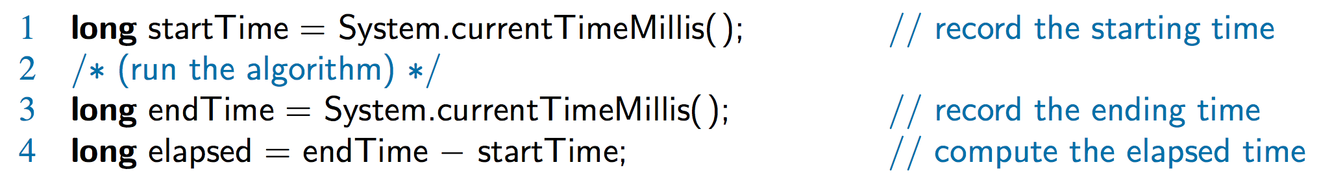
Experimental Studies
Write a program implementing the algorithm
Run the program with inputs of varying size and composition, noting the time needed:
Plot the results

Slide 5
Experimental Study- compose a String with n copies of character c
Runtime seems to roughly quadruple when input size is doubled
/** Uses repeated concatenation. */
public static String repeat1(char c, int n) {
String answer = "";
for (int j=0; j < n; j++)
answer += c;
return answer;
}
Runtime seems to roughly double when input size is doubled
/** Uses StringBuilder (read below notes). */
public static String repeat2(char c, int n) {
StringBuilder sb = new StringBuilder( );
for (int j=0; j < n; j++)
sb.append(c);
return sb.toString( );
}
answer = answer + c;
String class instances are immutable.
This operation creates a new string instance, copying all the characters of the existing string in the process. For long string, this can be very time consuming
Notes:
An important trait of Java’s String class is that its instances are immutable; once
an instance is created and initialized, the value of that instance cannot be changed.
This is an intentional design, as it allows for great efficiencies and optimizations
within the Java Virtual Machine.
However, because String is a class in Java, it is a reference type. Therefore,
variables of type String can be reassigned to another string instance (even if the
current string instance cannot be changed), as in the following:
String greeting = "Hello";
greeting = "Ciao"; // we changed our mind
It is also quite common in Java to use string concatenation to build a new string that
is subsequently used to replace one of the operands of concatenation, as in:
greeting = greeting + '!'; // now it is ”Ciao!”
However, it is important to remember that this operation does create a new string
instance, copying all the characters of the existing string in the process. For long
string (such as DNA sequences), this can be very time consuming.
In order to support more efficient editing of character strings, Java provides
a StringBuilder class, which is effectively a mutable version of a string. This
class combines some of the accessor methods of the String class, while supporting
additional methods including the following (and more):
setCharAt(k,c): Change the character at index k to character c.
insert(k, s): Insert a copy of string s starting at index k of the sequence, shifting existing
characters further back to make room.
append(s): Append string s to the end of the sequence.
reverse(): Reverse the current sequence.
toString(): Return a traditional String instance based on the current character sequence.
An error condition occurs, for both String and StringBuilder classes, if an index k
is out of the bounds of the indices of the character sequence.
The StringBuilder class can be very useful, and it serves as an interesting case
study for data structures and algorithms.

Slide 6
Limitations of Experiments
It is necessary to implement the algorithm, which may be difficult
Results may not be indicative of the running time on other inputs not included in the experiment.
In order to compare two algorithms, the same hardware and software environments must be used

Slide 7
Pseudocode & Primitive Operations
Pseudocode is:
a high-level description of an algorithm
More structured than English prose and less detailed than a program
Preferred notation for describing algorithms
Hides program design issues
Primitive Operations
Basic computations performed by an algorithm such as:
Evaluating an expression
Assigning a value to a variable,
Indexing into an array
Comparing two numbers
Following an object reference
Calling a method, returning from a method
Identifiable in pseudocode
Largely independent from the programming language
Exact definition not important (we will see why later)
Assumed to take a constant amount of time in the RAM model

Slide 8
Pseudocode Details
Method declaration
Algorithm method (arg [, arg…])
Input …
Output …
Control flow
if … then … [else …]
while … do …
repeat … until …
for … do …
Indentation replaces braces
Algorithm arrayMax(A, n)
Input array A of n integers
Output maximum element of A
currentMax ← A[0]
for i ← 1 to n − 1 do
if A[i] > currentMax then
currentMax ← A[i]
return currentMax
Method call: var.method (arg [, arg…])
Return value: return expression
Expressions
Assignment (like = in Java)
Equality testing (like == in Java)
n² Superscripts and other mathematical formatting allowed

Slide 9
Counting Primitive Operations
By inspecting the pseudocode, we can determine the maximum number of primitive operations executed by an algorithm
Most individual statements take 1 unit of time to run.
When multiple statements are executed sequentially, their runtimes are added.
In case of a loop, the runtime is multiplied by the number of repetitions.
Larger statements also occur sequentially, in which case their runtimes are added.
If larger statements are nested, their runtimes are multiplied.
statement1;
statement2;
statement3;
for (int i = 1; i <= N; i++) {
for (int j = 1; j <= N; j++) {
statement1;
}
}
3
3N²
for (int i = 1; i <= N; i++) {
statement4;
}
3N
8N + 3
for (int i = 1; i <= N; i++) {
statement5;
statement6;
statement7;
}
3N² + 8N +3
5N
How many statements will execute if N = 10? If N = 1000?

Slide 10
Theoretical Analysis
Uses a pseudocode instead of an implementation
Characterizes running time as a function of the input size, n.
Takes into account all possible inputs
Allows us to evaluate the speed of an algorithm independent of the hardware/software environment
Seven Important Functions often appear in algorithm analysis:
Constant, f(n)=c ≈ 1
Logarithmic, f(n) ≈ log n
Linear, f(n) ≈ n
N-Log-N, f(n) ≈ n log n
Quadratic, f(n) ≈ n²
Cubic/polynomial, f(n) ≈ n³
Exponential, f(n) ≈ 2^{n}

Slide 11
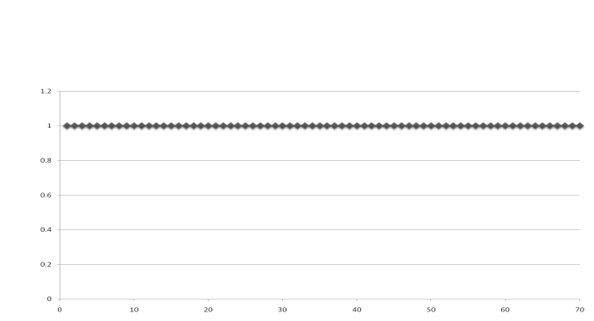
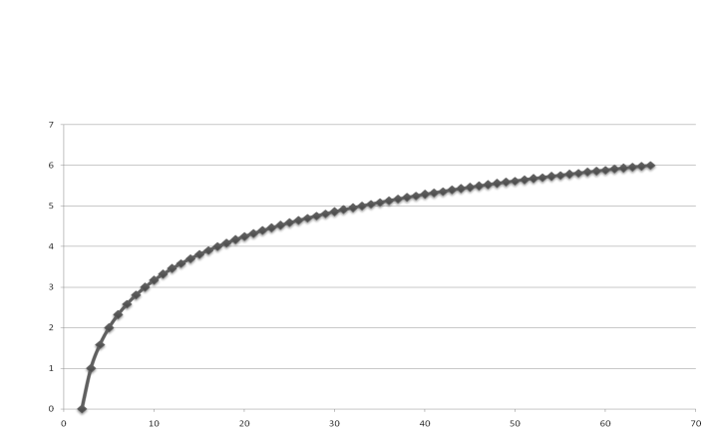
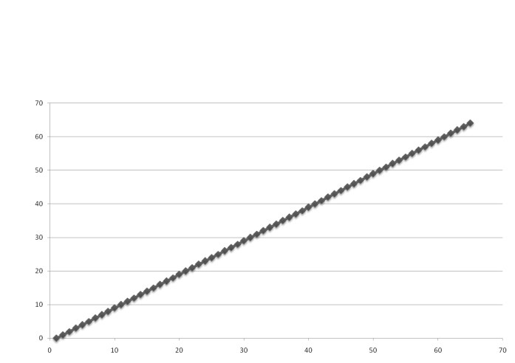
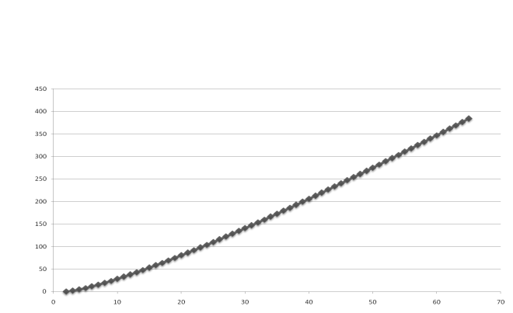
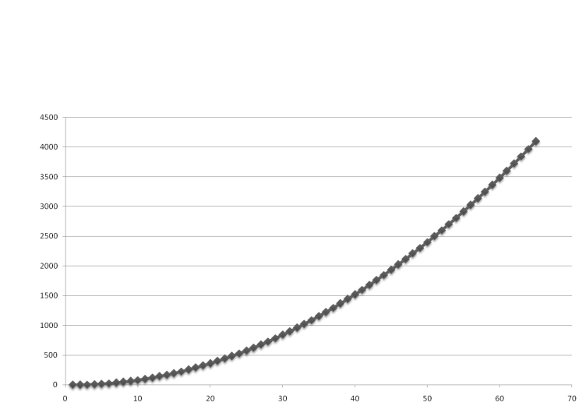
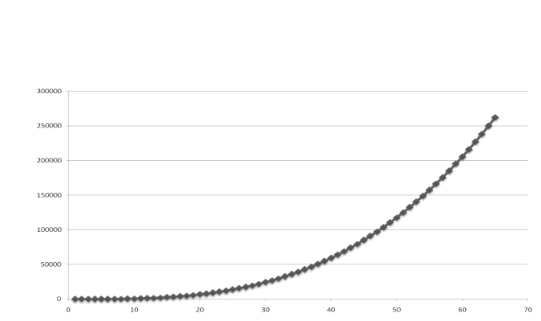
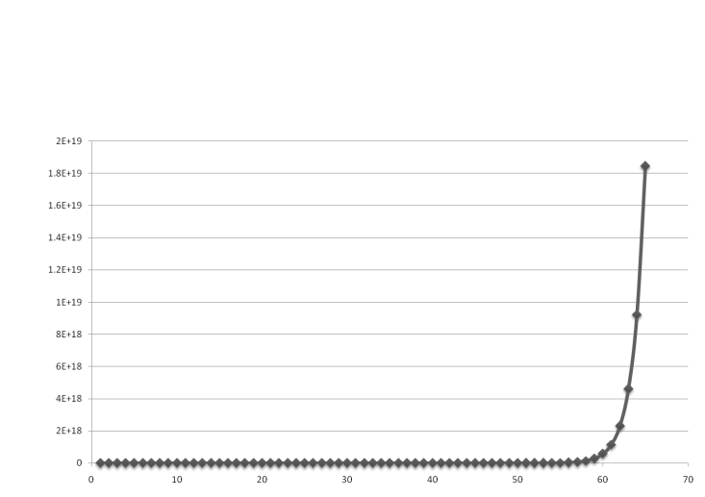
Functions Graphed Using “Normal” Scale
g(n) = n
g(n) = 1
g(n) = lg n
g(n) = n lg n
g(n) = n²
g(n) = n³
g(n) = 2^{n}

Slide 12
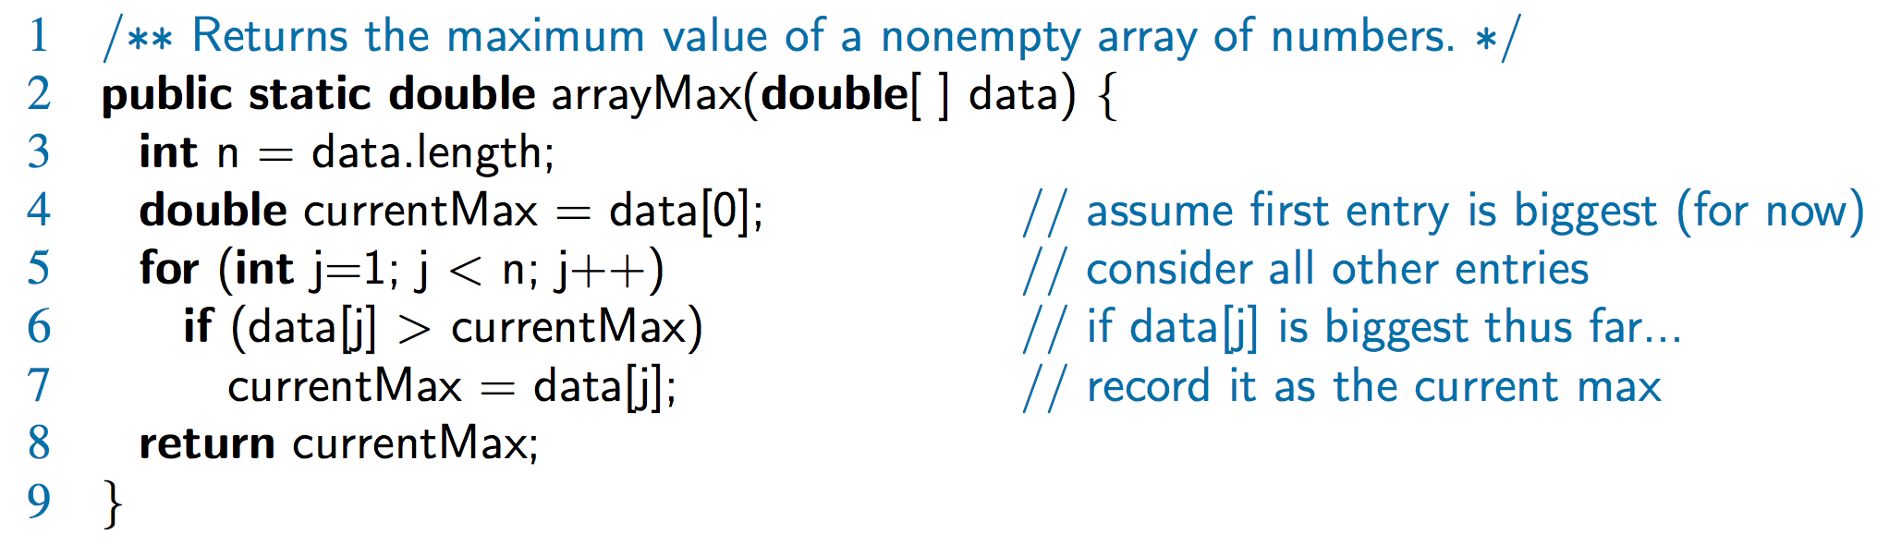
Estimating Running Time
By inspecting the pseudocode, we can determine the maximum number of primitive operations executed by an algorithm, as a function of the input size.
Step 3: 2 ops, 4: 2 ops, 5: 2n ops, 6: 2n ops, 7: 0 to n ops, 8: 1 op
Example: Algorithm arrayMax executes 5n + 5 primitive operations in the worst case, 4n + 5 in the best case. Define:
a = Time taken by fastest primitive operation
b = Time taken by slowest primitive operation
Let T(n) be worst-case running time of arrayMax. Then a (4n + 5 ) ≤ T(n) ≤ b(5n + 5 )
Hence, T(n) is bounded by two linear functions

Slide 13
Growth Rate of Running Time
Algorithm’s runtime can be expressed as a function of input size N
Growth Rate: measure of how quickly the graph of a function rises
Goal: distinguish between fast- and slow-growing functions
we only care about very large input sizes (for small sizes, most any algorithm is fast enough)
Changing the hardware/ software environment
Affects T(n) by a constant factor, but
Does not alter the growth rate of T(n)
Growth rate is not affected by
constant factors or
lower-order terms
Examples
10²n + 10⁵ is a linear function
10⁵n² + 10⁸n is a quadratic function

Slide 14
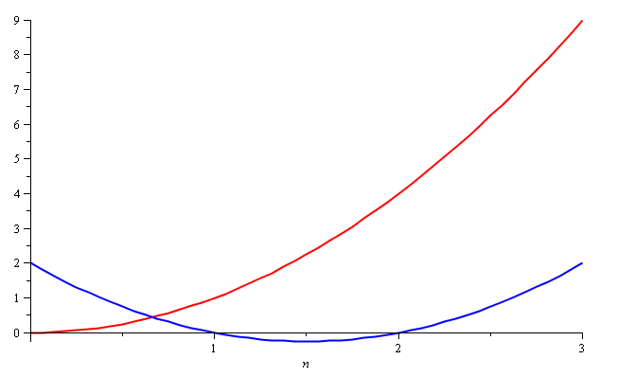
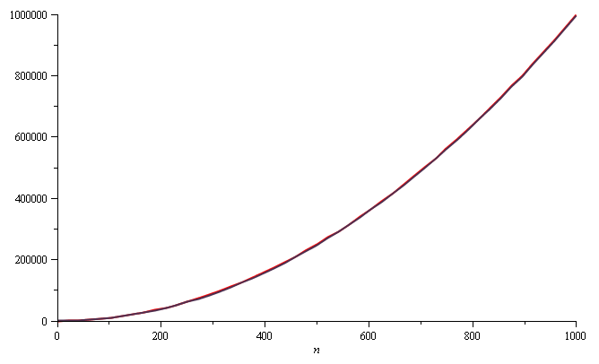
Quadratic Growth
Consider the two functions f(n) = n² and g(n) = n² – 3n + 2
Yet on the range n = [0, 1000], they are (relatively) indistinguishable
Around n = 0, they look very different
The absolute difference is large, for example,
f(1000) = 1 000 000 and g(1000) = 997 002
but the relative difference is very small
and this difference goes to zero as n → ∞

Slide 15
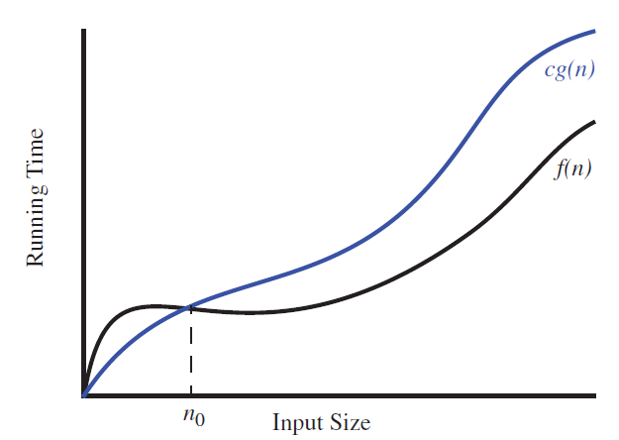
Landau Symbols- Big-Oh Notation
Given functions f(n) and g(n), we say that f(n) is O(g(n)) if there are positive constants c and n₀ such that
f(n) ≤ cg(n) for n ≥ n₀
we say “ f (n) is order of g(n).”
Big-Oh notation allows us to say that f (n) is “less than or equal to” g(n) up to a constant factor and in the asymptotic sense as n grows toward infinity.

Slide 16
Characterizing Running Times using the Big-Oh
Big-Oh characterizes running times and space bounds in terms of some parameter n
n varies from problem to problem,
but always defined as a chosen measure of the “size” of the problem.
Example: arrayMax algorithm
let n denote the number of elements of the array.
Using big-Oh notation, we can say (regardless of the hardware):
arrayMax runs in O(n) time
Justification:
Number of primitive operations executed in each iteration is a constant.
Thus, algorithm running time on input of size n is at most a constant times n

Slide 17
Big-Oh Notation-Example 1
Given functions f(n) and g(n), we say that f(n) is O(g(n)) if there are positive constants c and n₀ such that
f(n) ≤ cg(n) for n ≥ n₀
Example
2n + 10 is O(n)
2n + 10 ≤ cn
2n – cn ≤ -10
cn − 2n ≥ 10
(c − 2) n ≥ 10
n ≥ 10/(c − 2)
Pick c = 3 and n₀ = 10
7n-2 is O(n)
7n-2 ≤ c•n for n ≥ n₀ this is true for c = 7 and n₀ = 1

Slide 18
Big-Oh Notation-Example 2
Function n² is not O(n)
n² ≤ cn
n ≤ c
The above inequality cannot be satisfied since c must be a constant
Function n² is O(n²)
n² ≤ cn²
Pick c = 1 and n₀ = 1

Slide 19
Some Properties of the Big-Oh Notation
big-Oh notation ignores constant factors and lower order terms and focuses on the main components that affects function’s growth.
Example: 5n⁴ +3n³+2n² +4n+1 is O(n⁴)
5n⁴ +3n³+2n² +4n+1 ≤ (5+3+2+4+1)n⁴ = cn⁴ for c = 15, when n ≥ n₀ = 1.
we can characterize the growth rate of any polynomial function.
If f (n) is a polynomial of degree d, that is,
f (n) = a₀ + a₁n +···+ a_{d} n^{d} , and a_{d} > 0
then f (n) is O(n^{d})
Justification:
Note that, for n ≥ 1, we have 1 ≤ n ≤ n² ≤ ··· ≤ n^{d};
hence, a₀ + a₁n + a₂n² +···+ a_{d} n^{d} ≤ (a₀ + a₁+ a₂ +···+ a_{d})n^{d} .
Therefore, f (n) is O(n^{d}) by defining c=a₀+a₁+···+a_{d} and n₀ =1.
Thus, the highest-degree term in a polynomial determines the asymptotic growth rate of that polynomial

Slide 20
More Big-Oh Notation examples
5n² +3nlog n+2n+5 is O(n²)
Justification: 5n²+3nlog n+2n+5 ≤ (5+3+2+5)n² =cn², for c =15, when
n ≥ n₀ = 1
20n³ +10nlog n+5 is O(n³)
Justification: 20n³ +10nlog n+5 ≤ 35n³, for n ≥ 1.
3log n+2 is O(logn)
Justification: 3logn+2 ≤ 5log n, for n ≥ 2.
we use n ≥ n₀ = 2 (note that 3log n is zero for n = 1).
2^{n+2} is O(2^{n})
Justification: 2^{n+2} = 2^{n}2² = 4 ·2^{n}; hence, we can take c = 4 and n₀ = 1.
2n+100log n is O(n).
Justification: 2n+100log n ≤ 102n, for n ≥ n0 = 1; hence, we can take c= 102.

Slide 21
Characterizing Functions in Simplest Terms
Function f (n) = 4n³ +3n² is O(n⁵) or even O(n⁴),
but it is more accurate to say that f (n) is O(n³).
Analogy:
A hungry traveler driving along a long country road happens upon a local farmer walking home from a market.
the traveler asks the farmer : how much longer he must drive before he can find some food,
“certainly no longer than 12 hours,” is a valid answer
“you can find a market just a few minutes drive up this road.” is much more accurate (and helpful) answer,
big-Oh notation strives as much as possible to tell the whole truth.

Slide 22
Big-Oh Rules Summary
If is f(n) a polynomial of degree d, then f(n) is O(n^{d}), i.e.,
Drop lower-order terms
Drop constant factors
Use the smallest possible class of functions
Say “2n is O(n)” instead of “2n is O(n²)”
Use the simplest expression of the class
Say “3n + 5 is O(n)” instead of “3n + 5 is O(3n)”

Slide 23
Math you need to Review
Summations
Powers
Logarithms
Proof techniques
Basic probability
Properties of powers:
a^{(b+c)} = a^{b}a ^{c}
a^{bc} = (a^{b})^{c}
a^{b} /a^{c} = a^{(b-c)}
b = a ^{log}_{a}^{b}
b^{c} = a ^{c*log}_{a}^{b}
Properties of logarithms:
log_{b}(xy) = log_{b}x + log_{b}y
log_{b} (x/y) = log_{b}x - log_{b}y
log_{b}xa = alog_{b}x
log_{b}a = log_{x}a/log_{x}b

Slide 24
Relatives of Big-Oh: big-Omega Ω(g(n))
big-Oh notation says that a function is “less than or equal to” another function.
big-Omega notation is an asymptotic way of saying that a function grows at a rate that is “greater than or equal to” another function
f (n) is Ω(g(n)) if g(n) is O( f (n)), that is,
there is a real constant c > 0 and an integer constant n₀ ≥ 1 such that
f(n) ≥ c•g(n) for n ≥ n₀
f (n) is big-Omega of g(n)”)
3nlog n+2n is Ω(nlog n).
Justification: 3nlog n+2n ≥ 3nlog n, for n ≥ 2.

Slide 25
Relatives of Big-Oh: big-Theta Θ(g(n))
Another Landau symbol is Θ notation that allows us to say that two functions grow at the same rate, up to constant factors
A function f(n) = Θ(g(n)) if there exist positive constants, c₁, and c₂ and an integer constant n₀ ≥ 1 such that
c₁ g(n) ≤ f(n) ≤ c₂ g(n) n ≥ n₀
The function f(n) has a rate of growth equal to that of g(n)
3nlog n+4n+5logn is Θ(nlog n).
Justification: 3nlog n ≤ 3nlog n+4n+5logn ≤ (3+4+5)nlogn for n ≥ 2.

Slide 26
Intuition for Asymptotic Notation
Big-Oh :
f(n) is O(g(n)) if f(n) is asymptotically less than or equal to g(n)
big-Omega
f(n) is Ω(g(n)) if f(n) is asymptotically greater than or equal to g(n)
big-Theta
f(n) is Θ(g(n)) if f(n) is asymptotically equal to g(n)
5n² is O(n²)
f(n) ≤ c•g(n) 5n² ≤ c.n² for n ≥ n₀ let c = 5 and n₀ = 1
5n² is Ω(n²)
f(n) ≥ c•g(n) 5n² ≥ c.n² for n ≥ n₀ let c = 1 and n₀ = 1
5n² is Θ(n²)
c₁ g(n) ≤ f(n) ≤ c₂ g(n) c1.n² ≤ 5n² ≤ c2.n²
Let c1 = 1, c2=5 and n₀ = 1

Slide 27
Asymptotic Algorithm Analysis
To perform the asymptotic analysis
We find the worst-case number of primitive operations executed as a function of the input size
We express this function with big-Oh notation
Example:
Algorithm arrayMax executes at most 5n + 5 primitive operations
We say that algorithm arrayMax “runs in O(n) time”
Since constant factors and lower-order terms are eventually dropped anyhow, we can disregard them when counting primitive operations

Slide 28
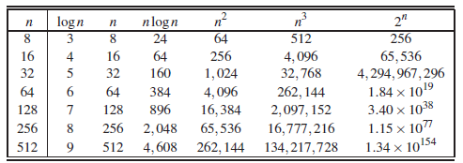
Asymptotic Algorithm Analysis
Two algorithms A and B solving the same problem
A has a running time of O(n), and B has a running time of O(n²).
Which algorithm is better?
A is asymptotically better than algorithm B, although for a small value of n, B may have a lower running time than A.
We use the big-Oh notation to order the 7 functions by asymptotic growth rate: 1 logn n nlogn n² n³ 2^{n}
growth rates of some important functions

Slide 29
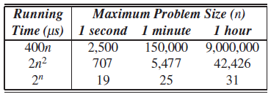
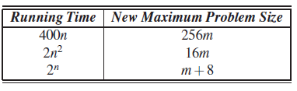
Asymptotic Algorithm Analysis
Maximum size allowed for an input instance that is processed by an algorithm in 1 second, 1 minute, and 1 hour.
Asymptotically slow algorithm is beaten in the long run by an asymptotically faster algorithm,
Dramatic speed-up in hardware cannot overcome the handicap of an asymptotically slow algorithm.
New maximum problem size achievable for any fixed amount of time, assuming algorithms with the given running times are now run on a computer 256 times faster than the previous one
Each entry is a function of m, the previous maximum problem size

Slide 30
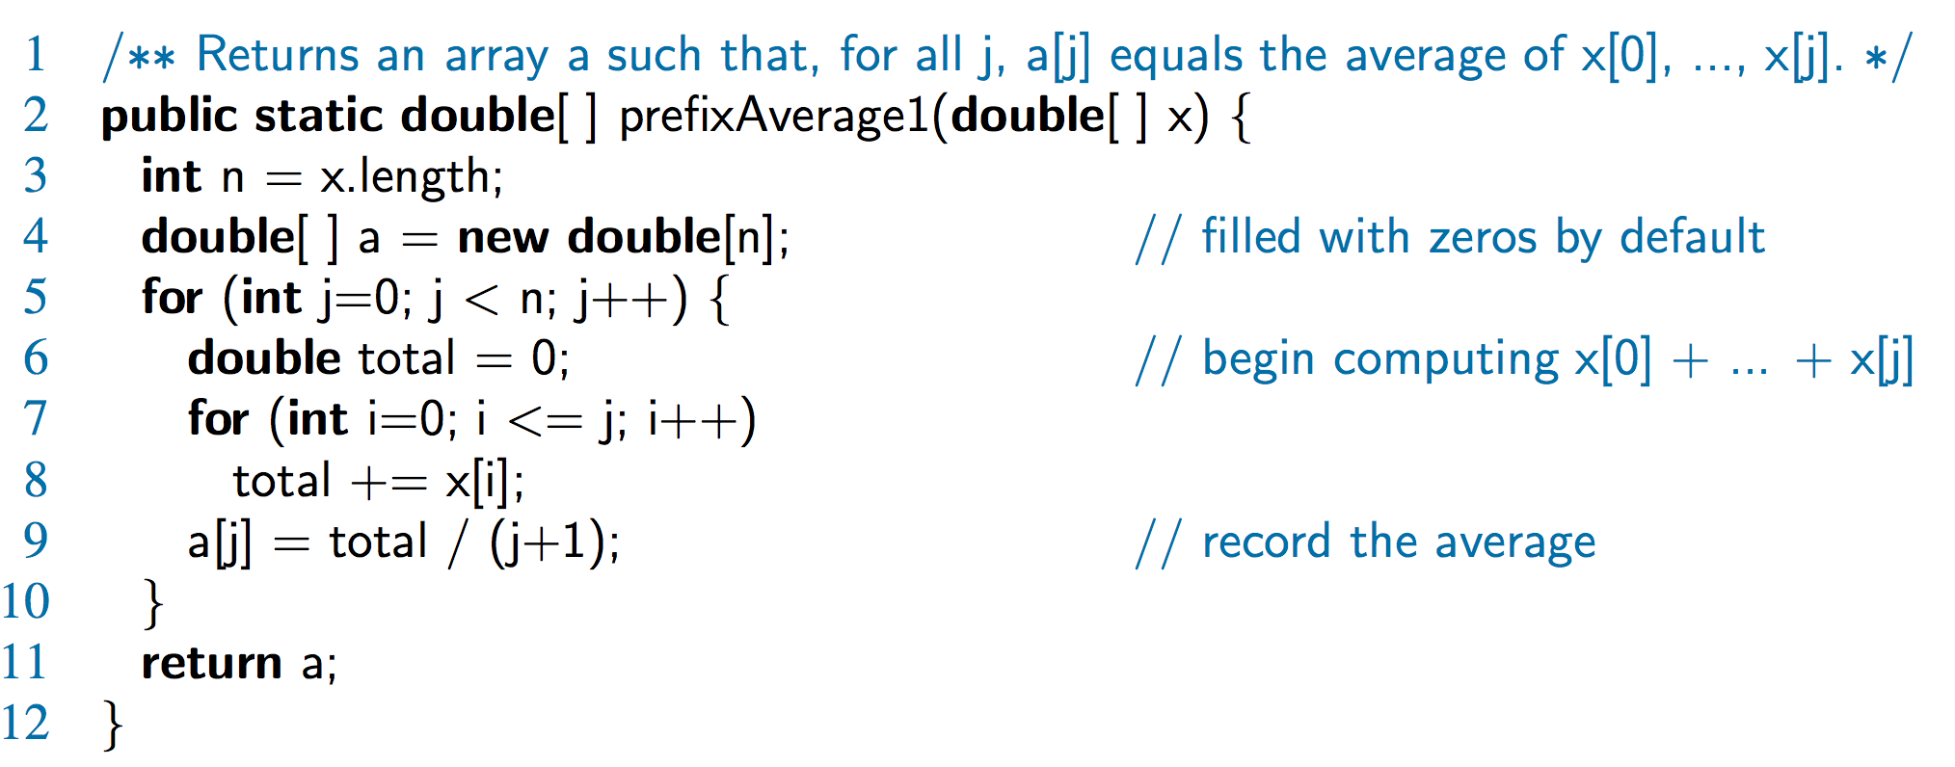
Computing Prefix Averages
Illustrate asymptotic analysis with two algorithms for prefix averages
A[i] is average of first (i + 1) elements of X:
A[i] = (X[0] + X[1] + … + X[i])/(i+1)
Algorithm prefixAverages1(X, n)
Input array X of n integers
Output array A of prefix averages of X #operations
A ← new array of n integers n
for i ← 0 to n − 1 do n
s ← X[0] n
for j ← 1 to i do 1 + 2 + …+ (n − 1)
s ← s + X[j] 1 + 2 + …+ (n − 1)
A[i] ← s / (i + 1) n
return A 1
Running time of prefixAverages1 is O(1 + 2 + …+ n)
Sum of the first n integers is n(n + 1) / 2
1+2+3+···+n = n(n+1)/2,
Thus, algorithm prefixAverages1 runs in O(n²) time

Slide 31
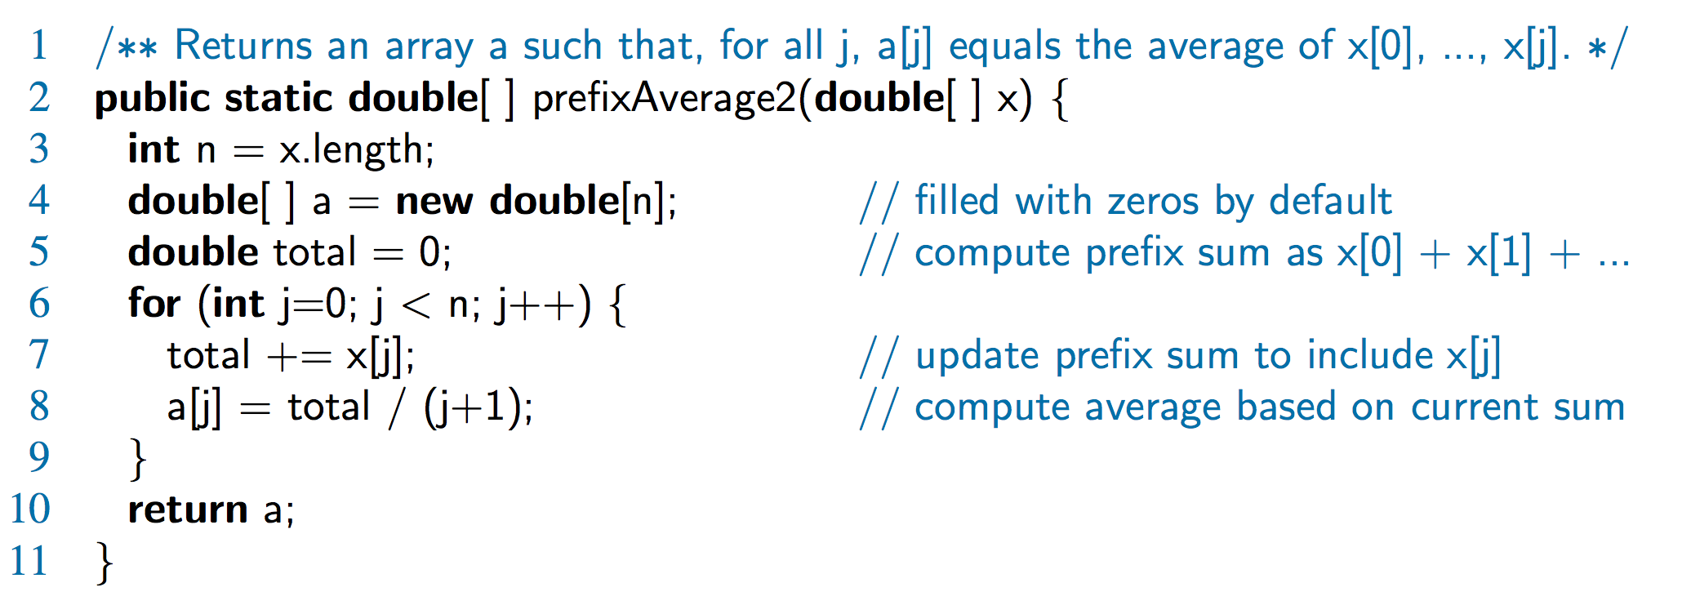
Prefix Averages (Linear)
The following algorithm computes prefix averages in linear time by keeping a running sum
Algorithm prefixAverages2(X, n)
Input array X of n integers
Output array A of prefix averages of X #operations
A ← new array of n integers n
s ← 0 1
for i ← 0 to n − 1 do n
s ← s + X[i] n
A[i] ← s / (i + 1) n
return A 1
Algorithm prefixAverages2 runs in O(n) time

Slide 32
Program loop runtimes
Loop executes its body exactly N / c times
for (int i = 0; i < N; i += c) // O(N)
<statements>;
for (int i = 1; i <= N; i *= c) // O(log N)
<statements>;
for (int i = 0; i < N * N; i += c) // O(N²)
<statements>;
for (int i = 0; i < N; i += c) { // O(N²)
for (int j = 0; j < N; i += c) {
<statements>;
}
}
for (int i = 0; i < N; i += c) { // O(N log N)
for (int j = 0; j < N; i *= c) {
<statements>;
}
}
Loop executes its body exactly log_{c} N times.
Loop executes its body exactly (N² / c) times.

Slide 33
Loop runtime problems
Approximate the value of the variable sum after the following code fragment, as an expression in terms of input size n. Use Big-Oh notation to describe the algorithm's overall runtime.
int sum = 0;
for (int i = 1; i <= N; i *= 2) {
sum++;
}
for (int i = 1; i <= N; i++) {
sum++;
sum++;
}
int sum = 0;
for (int i = 1; i <= N; i++) {
for (int j = 1; j <= i / 2; j += 2) {
sum++;
}
}

